Slide 1
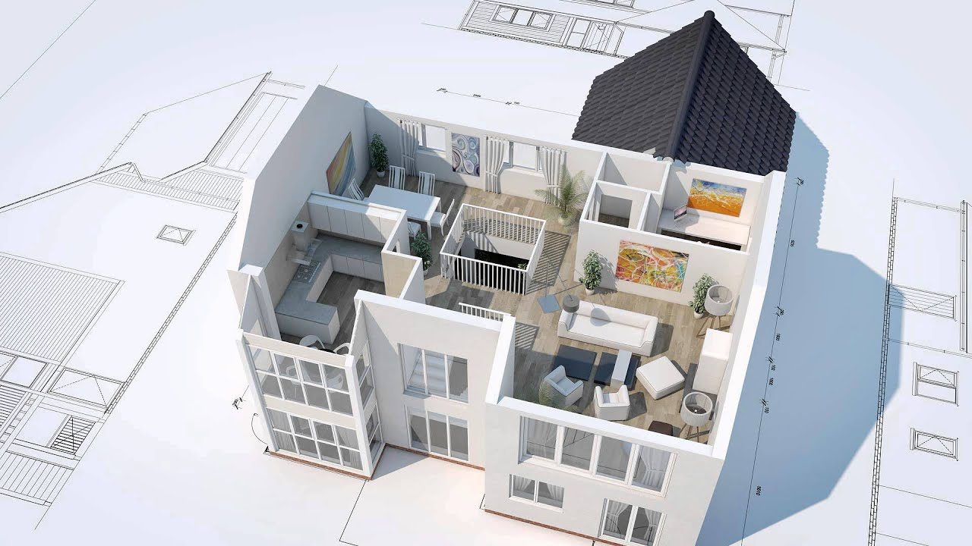
AUTOGENERATION OF 3D MODEL FROM ROOM IMAGES
2016-CE-54
2016-CE-72
2016-CE-81
2016-CS-159

Slide 2
1. OVERVIEW OF PROJECT
This project intent to the auto-generation of 3D models from 2D imported floor plans. It can be operated by importing a 2D floor plan in an image format. The techniques of image processing and model mapping used to generate the 3d computer graphics model according to the imported 2D floor plan. The 3D modification function provides ability to change the texture of floor and walls; moreover, it also enables users to add furniture in 3D constructed model. User can look at 3D model from different viewpoints i.e. top-view, walk-through, front-view and side-view.

Slide 3
1.1 PROBLEM STATEMENT
When anyone plans to construct a new at/house and can only see its floor plan. So it's hard for anyone to imagine the actual environment by just seeing 2-D floor plan. So, our system will enable the users to see this 2-D floor plan into 3-D.

Slide 4
1.2 MOTIVATION
A common user or an artist who does not know how their home look after construction and proper adjustment of their accessories, it's a big platform for them to see their house in 3D more than their imagination. Already existing such systems can only used by technical users because a lot of manual work is required to construct 3D model from 2D le format. So, this motivates us to automatically generate 3D model from an imported 2D floor plan image by just clicking a button.

Slide 5
2. OBJECTIVE OF PROJECT

Slide 6
3. SCOPE OF THE PROJECT

Slide 7
4. IDEA COMPLEXITY

Slide 8
5. EXISTING SYSTEM

Slide 9
6. PROPOSED SYSTEM

Slide 10
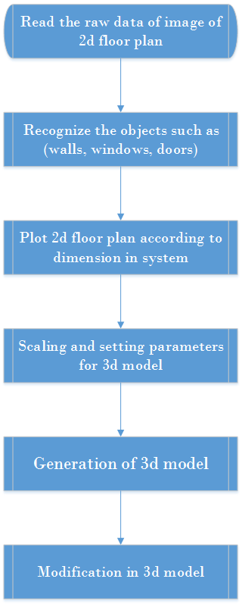
7. METHODOLOGY

Slide 11
8. POSSIBLE APPLICATION OF WORK

Slide 12
9. MARKET SURVEY

Slide 13
10. FEASIBILITY STUDY

Slide 14
11. TARGET AUDIENCE

Slide 15
12. LIMITATIONS AND CHALLENGES

Slide 16


